Slide 1
Tech Layoffs Final Presentation
Group 1: Anitha Shivaramaiah, Brayan Murillo Gutierrez, Robert Fajardo, and Kevin Raj

Slide 2
Data Abstraction-Business Formation
Attribute Name | Attribute Type
sa | Categorical (2 classes)
naics_sector | Categorical (21 classes)
series | Categorical (12 Classes)
geo | Categorical/position (56 Classes)
year | Quantitative (2004-2023)
jan | Quantitative ( 0 - inf )
feb | Quantitative ( 0 - inf )
mar | Quantitative ( 0 - inf )
apr | Quantitative ( 0 - inf )
may | Quantitative ( 0 - inf )
jun | Quantitative ( 0 - inf )
jul | Quantitative ( 0 - inf )
aug | Quantitative ( 0 - inf )
sep | Quantitative ( 0 - inf )
oct | Quantitative ( 0 - inf )
nov | Quantitative ( 0 - inf )
dec | Quantitative ( 0 - inf )
Business Formation Dataset, summary of business formation in US. This dataset is a flat-table and dynamic (31388, 17)

Slide 3
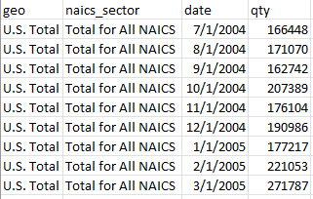
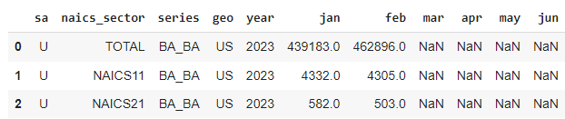
Cleaning Data
Business Formation Dataset/ Laid-offs Dataset:
Convert into human friendly version.
Change architecture / derive new attributes.
Filter out undesired rows and columns.
Impute/drop rows with null values.
Sort

Slide 4
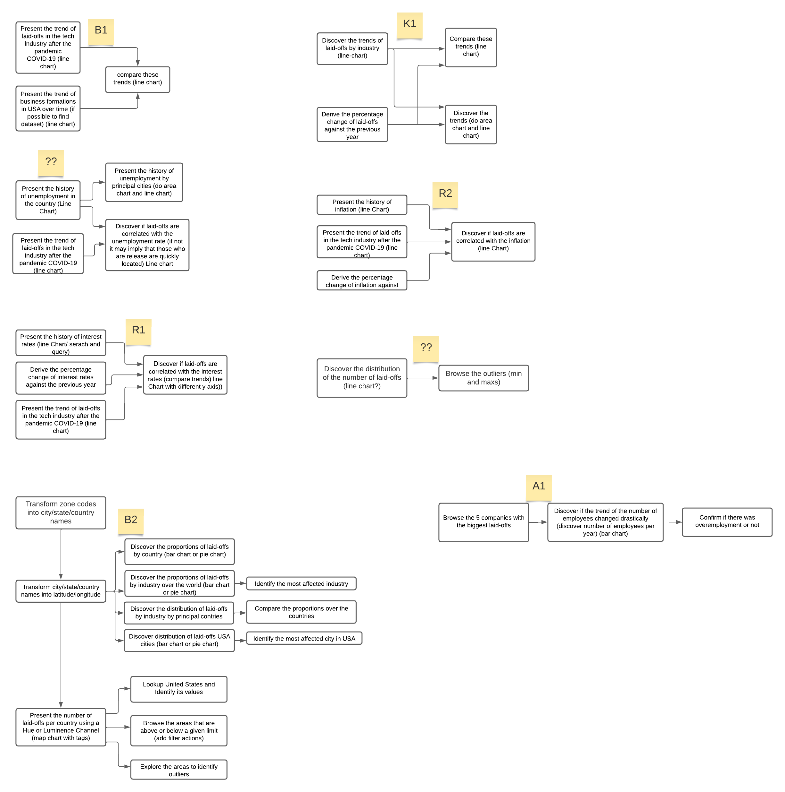
Task Abstraction

Slide 5
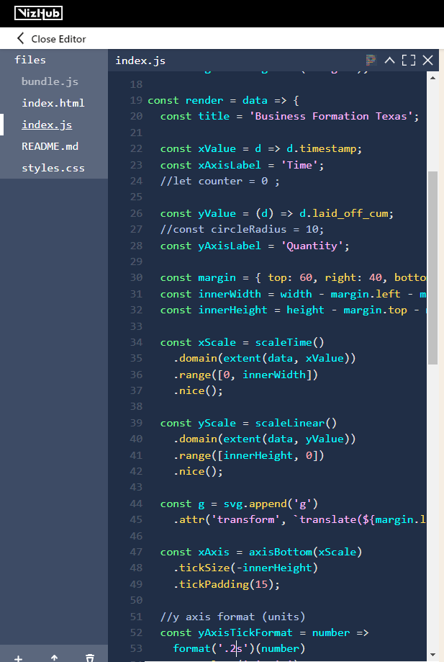
Implementation
Line Chart in VizHub with d3.js:
HTML, CSS, Javascript and d3.js.
SVG, AxisBottom, AxisLeft, LineGenerator, <g>, <path>.
Map to desired Attributes.

Slide 6
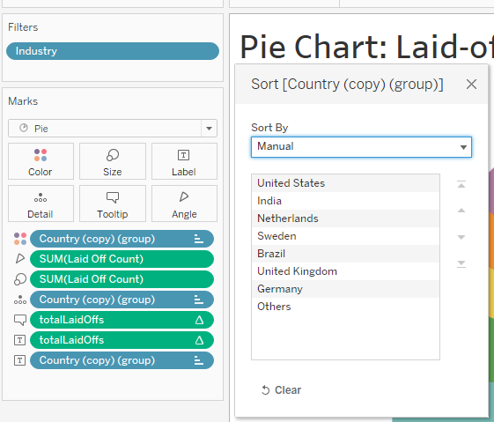
Implementation
Map Chart, Pie Chart, Bar Chart and table summary in Tableau:
Derive attributes (latitude/longitude/cumulative sums).
Following the attribute type and task → idiom.
Add filters.
Add actions.
Change color.
Set tooltip and detail.
Make Groups
Sort visualization
Create Dashboards

Slide 7
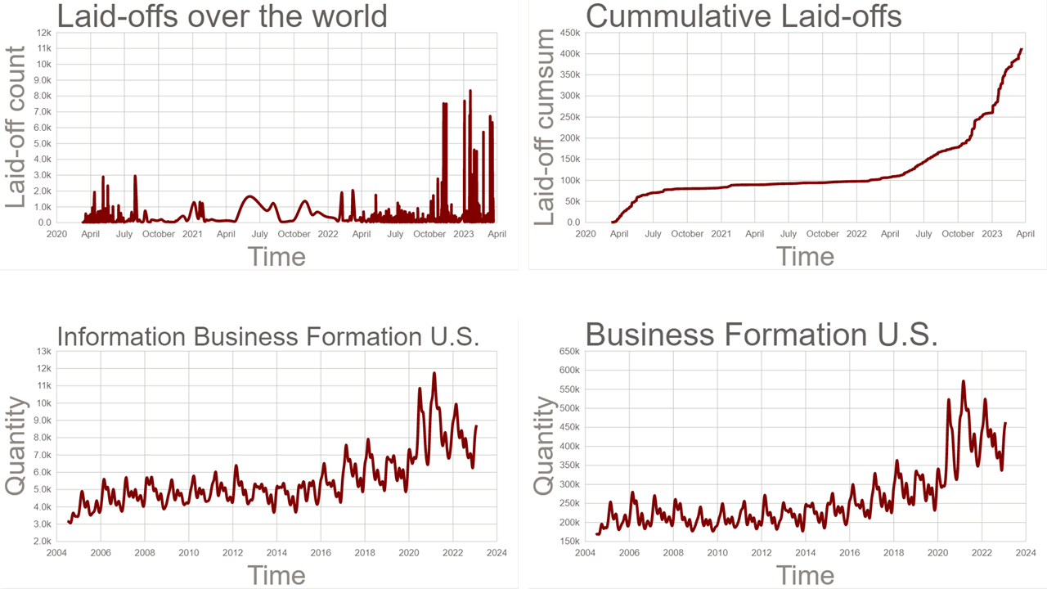
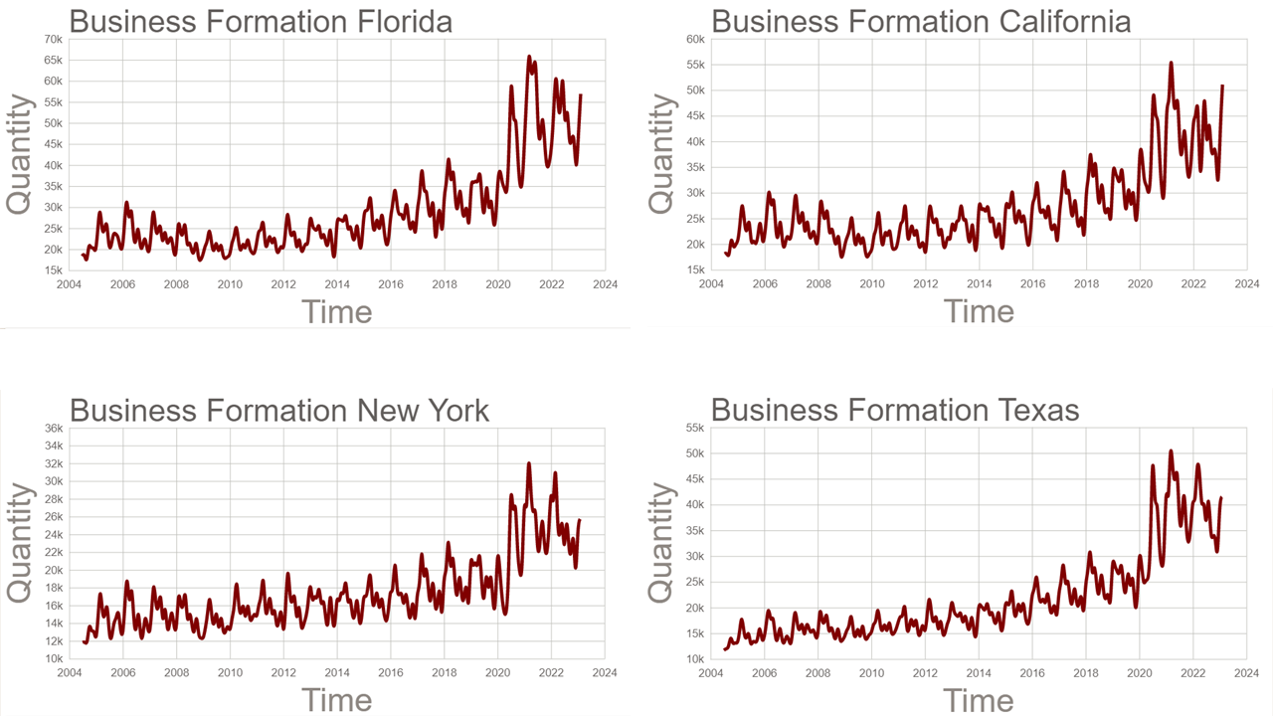
Results

Slide 8
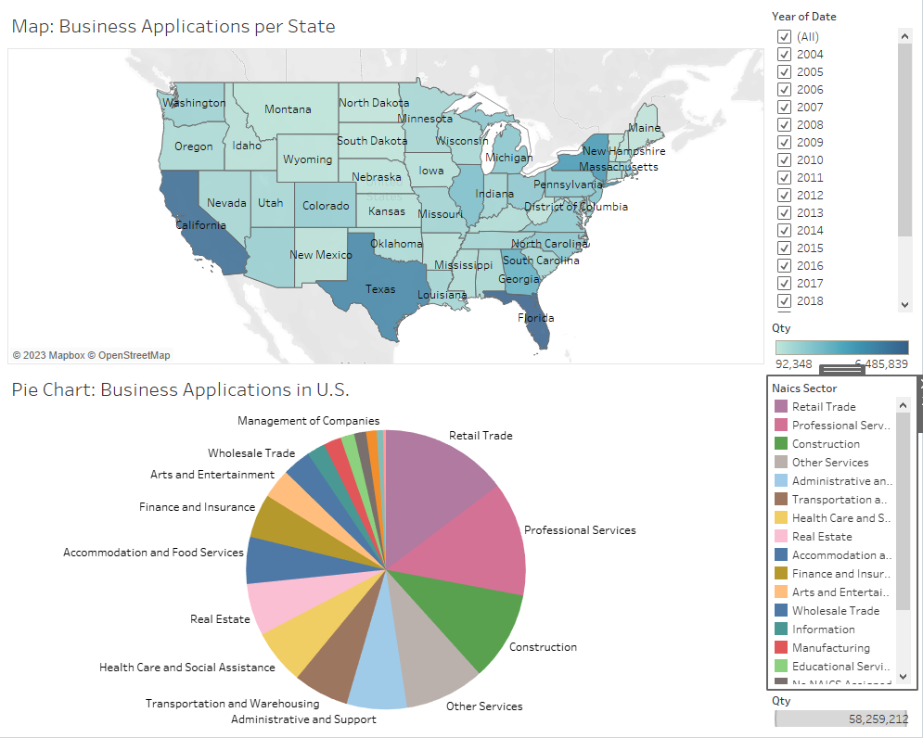
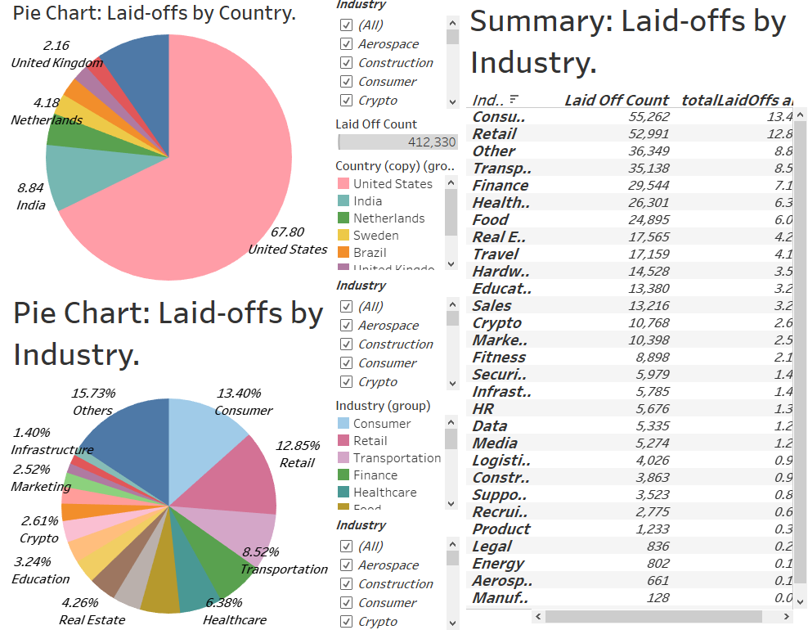
Results

Slide 9
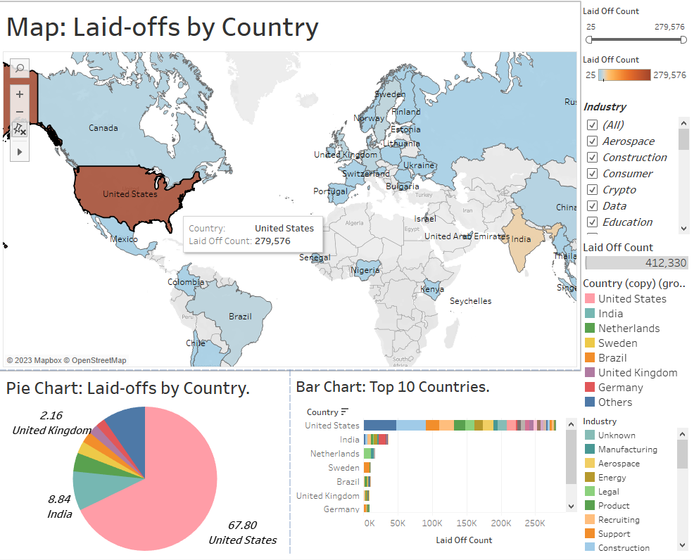
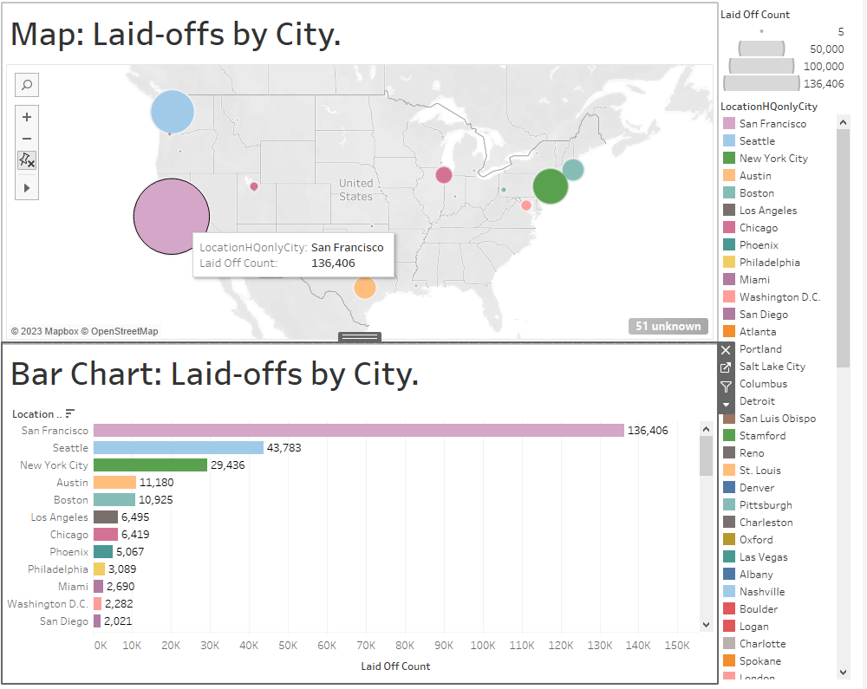
Results

Slide 10
Data Abstraction-FRED Inflation
Attribute Name | Attribute Type
date | ordinal (2018-2023)
Inflation_rate | Quantitative (0-inf)
Data contains two columns date (ordinal), and inflation-rate (quantitative), with 1,305 rows, giving us a size of 20.5Kb. Queried from (https://fred.stlouisfed.org/series/FPCPITOTLZGUSA)

Slide 11
Data Abstraction-FRED Borrowing Rates
Attribute Name | Attribute Type
date | ordinal (2018-2023)
FEDFUNDS | Quantitative (0-inf)
The data has 2 columns, Date (ordinal) and FEDFUNDS(quantitative) with 51 rows and a data size of 944 bytes. The data is queried from the FRED website site (https://fred.stlouisfed.org/series/FEDFUNDS)

Slide 12
Data Abstraction-Tech Layoff Monthly Data
Attribute Name | Attribute Type
Year_month | ordinal (2020-2023)
Layoff_count | Quantitative (0-inf)
The data has 2 columns, Date (ordinal) and Layoff_count (quantitative) with 38 rows and a data size of 576 bytes.

Slide 13
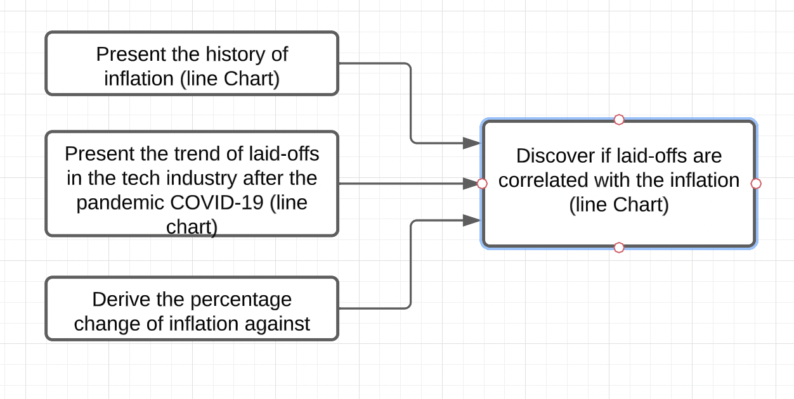
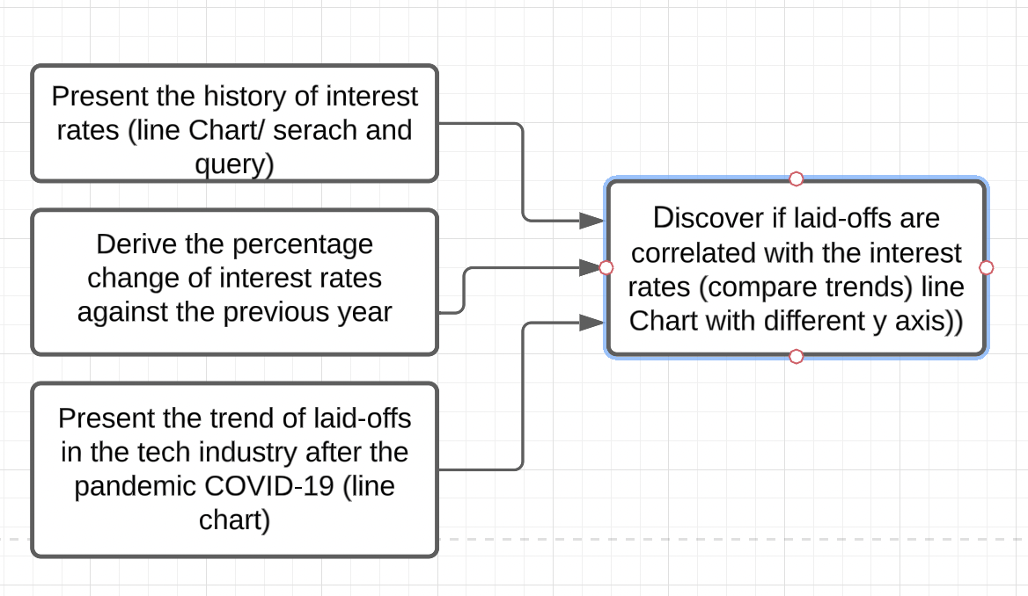
Task Abstraction

Slide 14
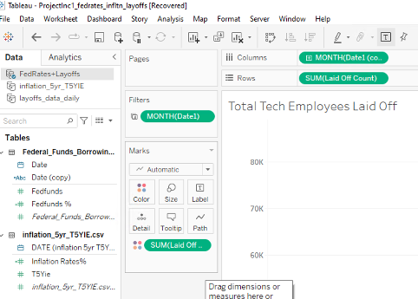
Implementation
Line Charts and Crosstab Tables in Tableau:
Following the attribute type and task → idiom.
Add filters.
Add actions (filters and highlights)
Change color to reflect quantitative values.
Set tooltip and detail.
Sort visualization
Create Dashboards

Slide 15
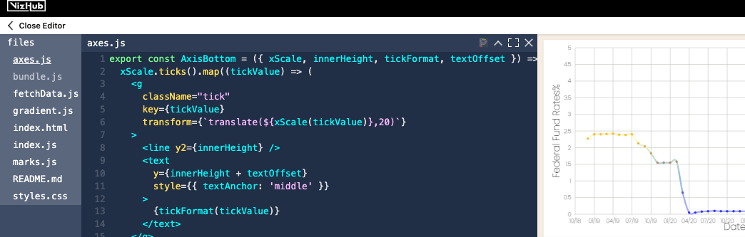
Implementation
Line Charts in D3:
Following the attribute type and task → idiom.
Change color to reflect quantitative values and calculations. Design gradient marks using Hex codes
Sort visualization and respective axes

Slide 16
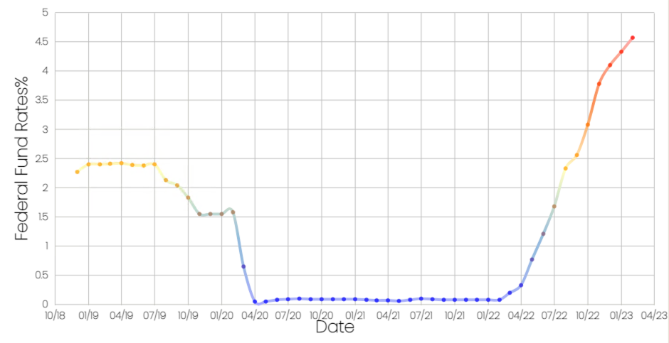
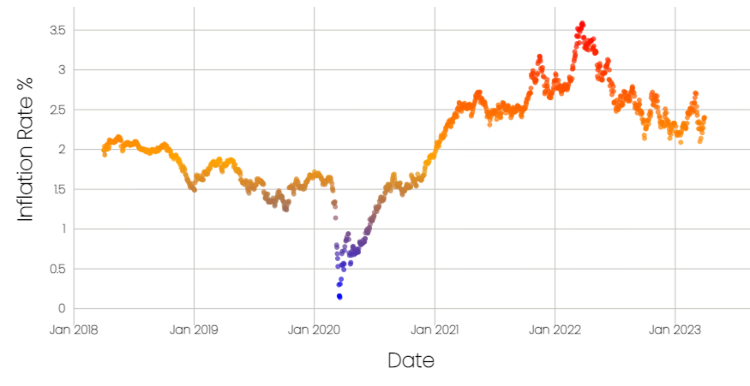
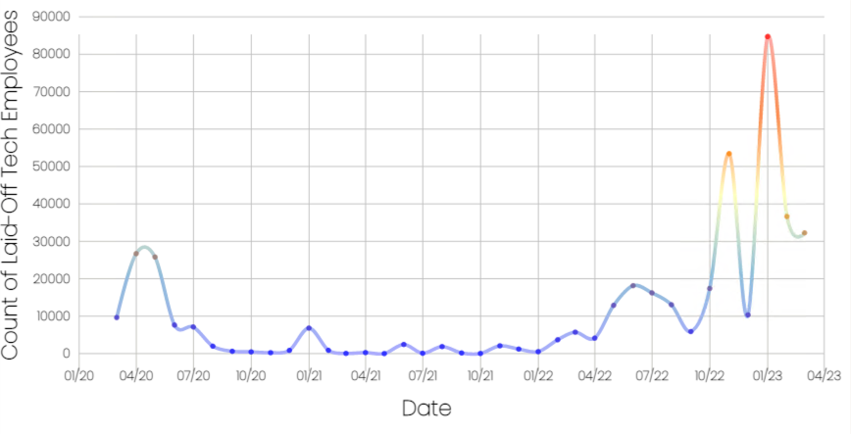
D3 Results

Slide 17
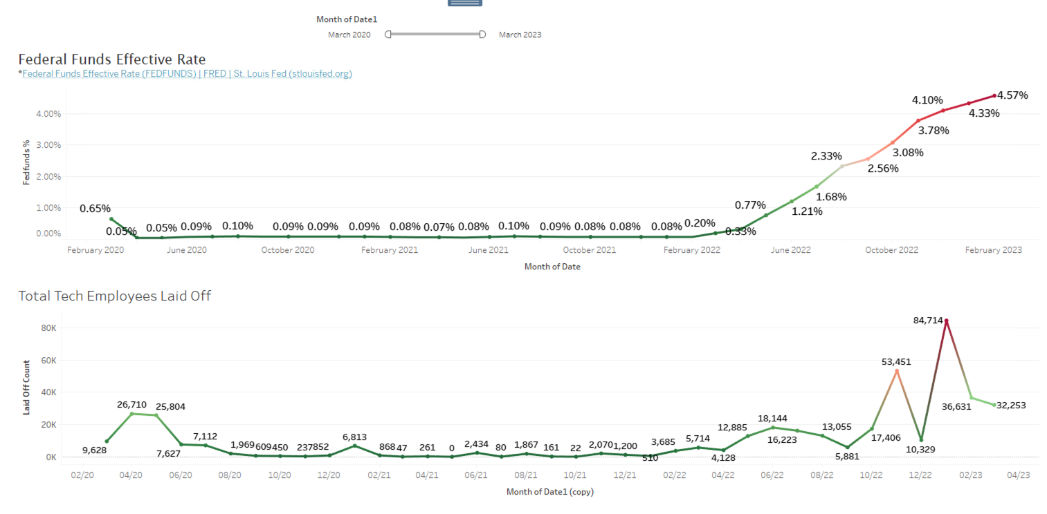
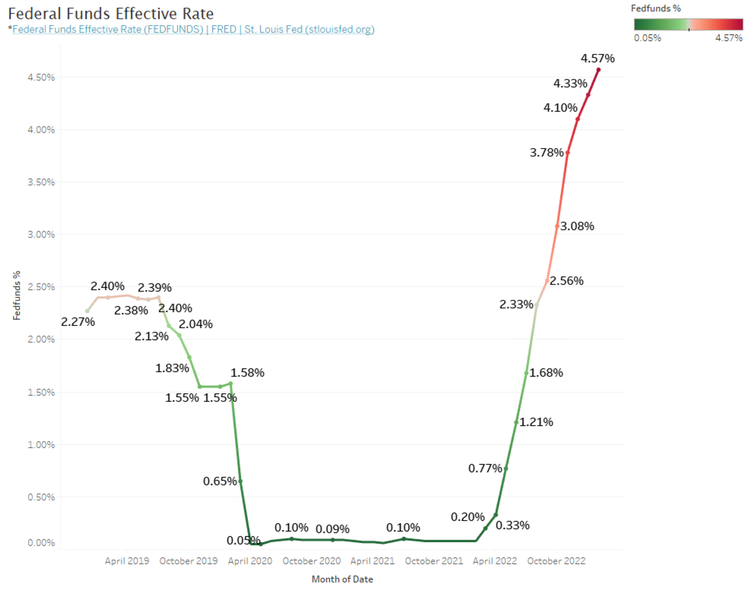
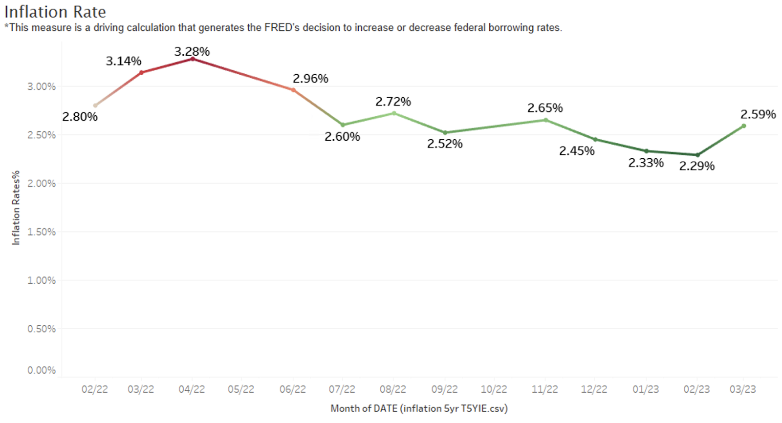
Tableau Results

Slide 18
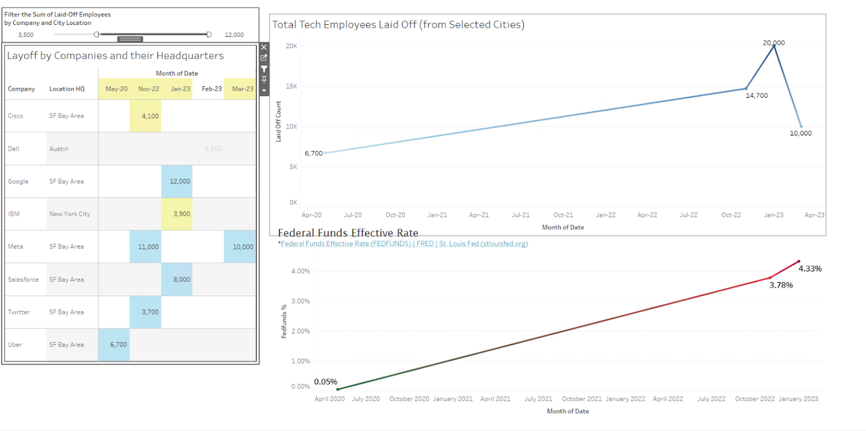
Tableau Results
Search, Query and Derive: Layoff counts by company, location (SF) and derive fed rates

Slide 19
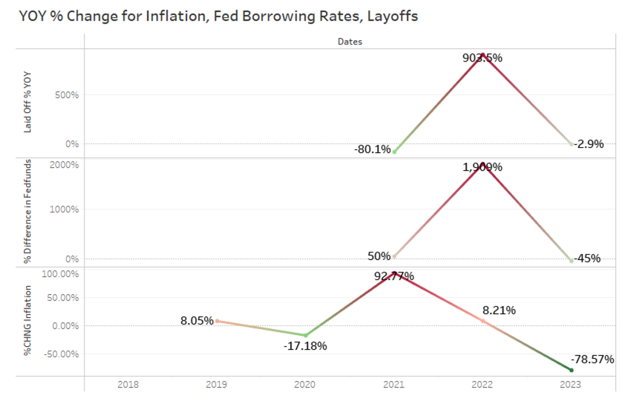
Tableau Results
Visualizing the reaction of inflation and fed rate movement to tech layoffs

Slide 20

Data Abstraction-Layoffs.fyi data set
Attribute Name | Attribute Type
company | Categorical
location | Categorical
industry | Categorical
total_laid_off | Ordinal
percentage_laid_off | Quantitative
date | Quantitative
stage | Categorical
country | Categorical
funds_raised | Quantitative
Data set shows 1,951 unique records of tech companies experiencing layoffs.
Data set pulled from Kaggle showing data since March 2020 (beginning of COVID-19 pandemic) through March 2023.
City and country of company headquarters are also shown in dataset.

Slide 21
Task Abstraction
Examine the top 20 companies in the layoffs.fyi dataset and observe the percentage of total layoffs for each company in the subset of top 20 companies.
Present the number of layoffs over time by quarter in a line chart based on the layoffs.fyi dataset.
Discover the cumulative number of layoffs over time by quarter in a line chart and step chart based on the layoffs.fyi dataset.
Examine the percentage of layoffs by funding stage and observe the funds raised as color luminance to determine which funding stage has the highest funds raised and highest layoffs.
Examine the relationship between percentage of total funds raised and percentage of total layoffs to determine if companies raising significant capital have higher layoffs or vice versa (do companies raising less capital have lower layoffs?)

Slide 22
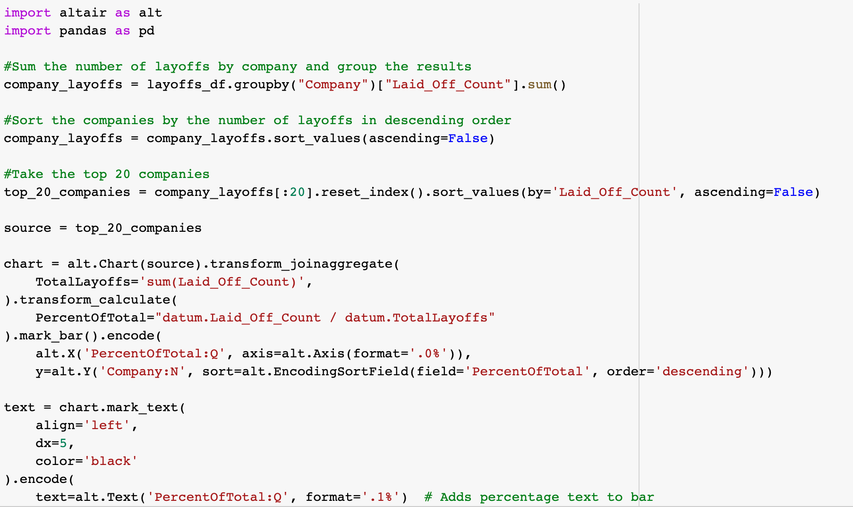
Implementation
Altair/Pandas Python Package
Read csv of layoffs.fyi dataset from Gist using Pandas.
Sum number of layoffs by quarter using Pandas.
Use Altair to create the bar, line, and step charts.

Slide 23
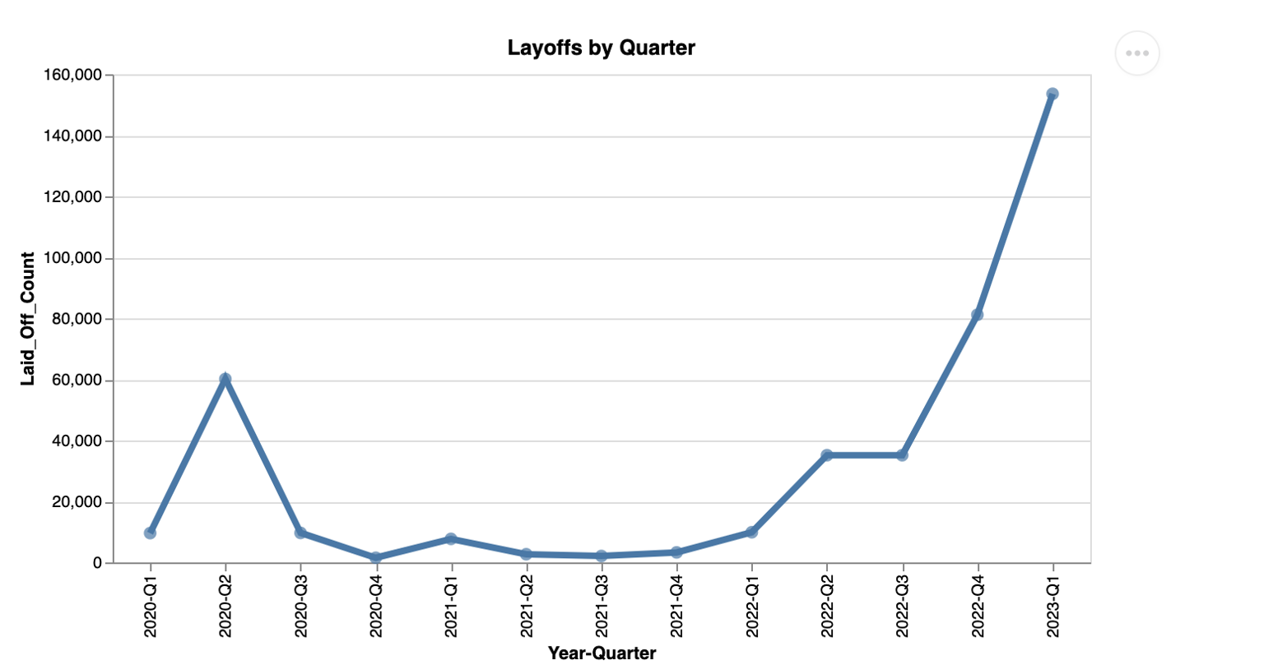
Results
We can observe from the line chart the number of layoffs started to increase dramatically starting in Q4 of 2022.
The layoffs nearly doubled from approximately 80,000 layoffs in Q4 2022 to nearly 160,000 layoffs in Q1 2023.
The first 3 months of 2023 had more layoffs than all of 2022 The uncertain macroeconomic environment is contributing to the rapid increase in layoffs.
Layoffs by Quarter

Slide 24
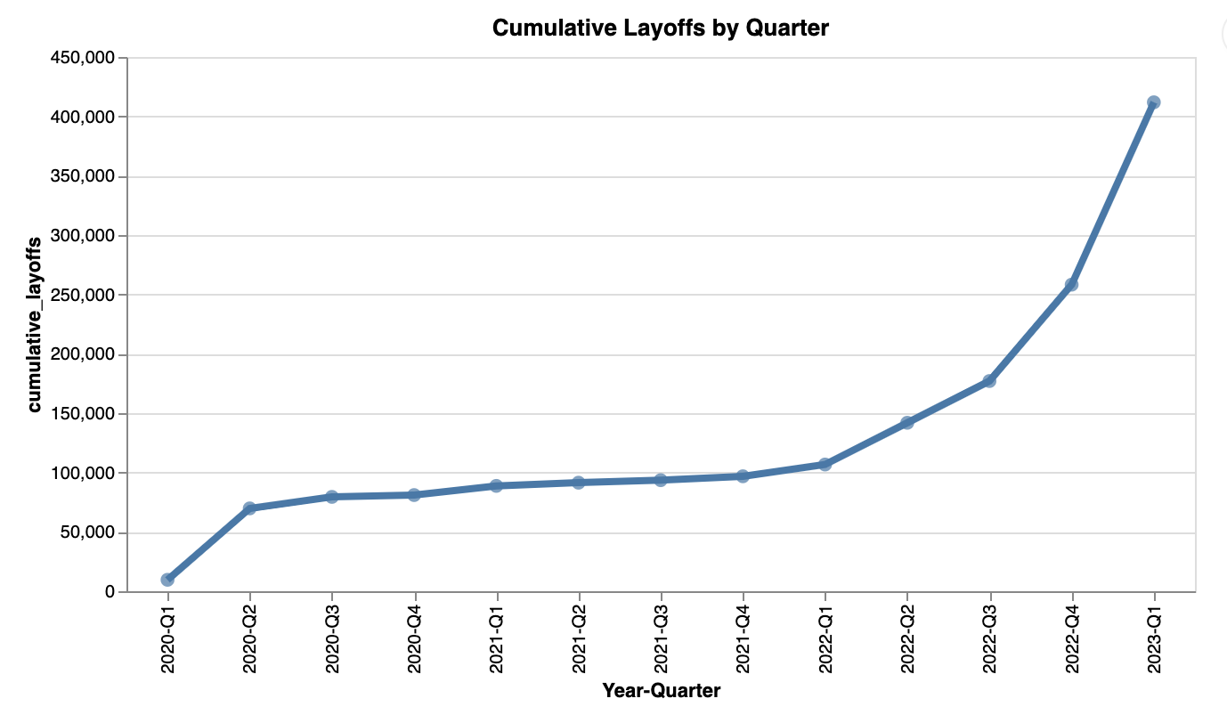
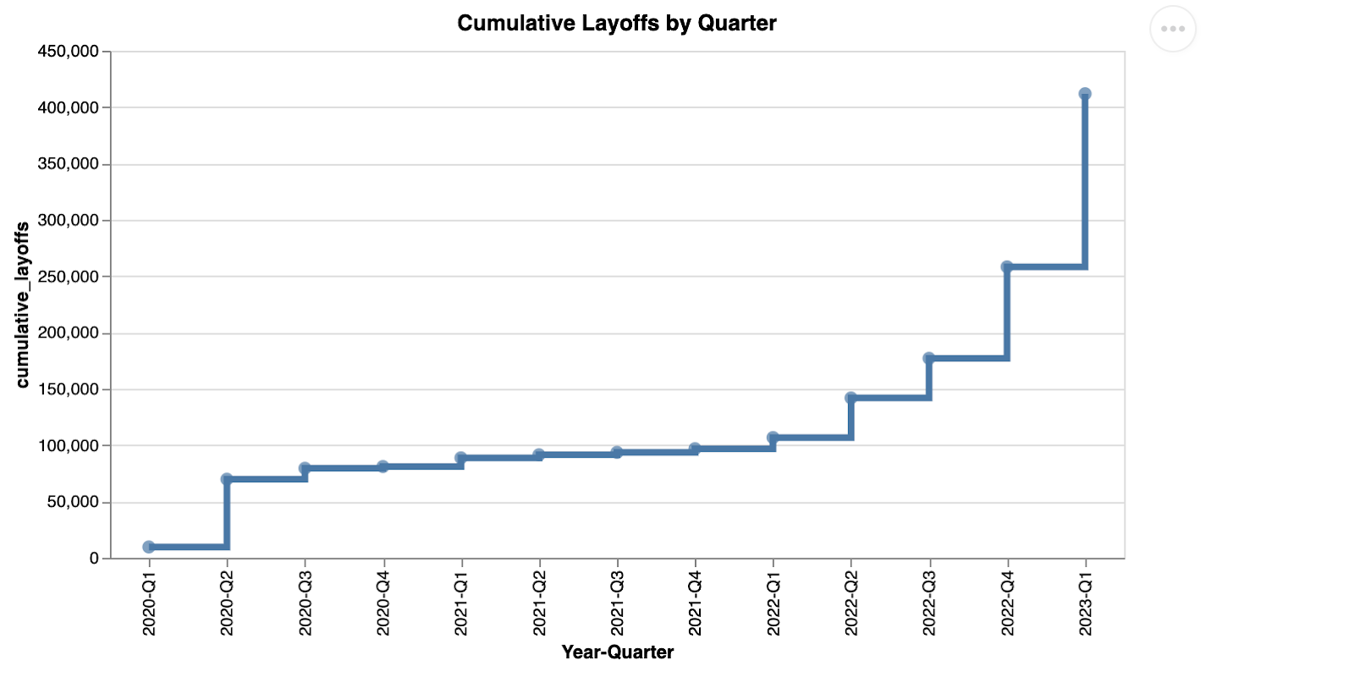
Results
Layoffs by Quarter (Line and Step Chart)
We can observe a sharp increase in layoffs from Q4 2022 to Q1 2023.
The uncertain macroeconomic environment likely contributed to the increase in layoffs, and in March 2023 a banking crisis occurred with Silicon Valley Bank filing for bankruptcy causing a banking crisis.
Since Silicon Valley Bank was instrumental in providing lending to tech start-ups, the bank’s demise could also be contributing to tech layoffs. The rise in interest rates, higher cost of living, high inflation rates are all contributing to an uncertain economic environment which is leading to layoffs.

Slide 25
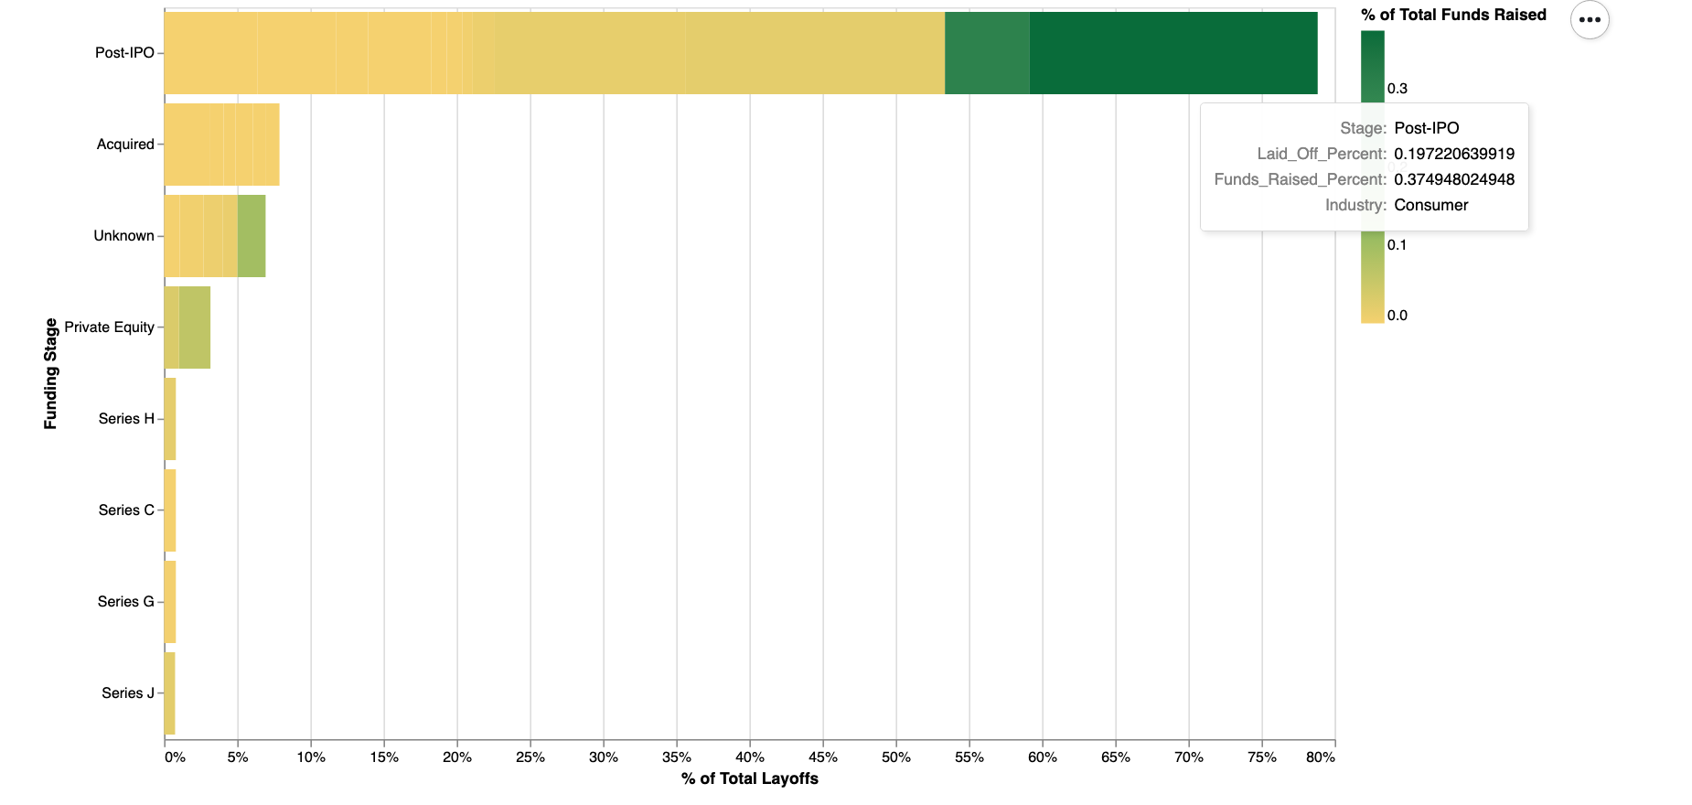
Results
We can observe from the bar chart that most of the layoffs (~80%) are for companies in the Post-IPO funding stage based on the subsection of data showing the top 50 companies with the highest number of layoffs.
Google and Meta are both classified as Consumer industry in the Post-IPO stage as established companies. Both companies had significant layoffs and raised high levels of capital.
To minimize costs, these companies who raise significant levels of capital may be subject to demands from institutional investors and would lay off employees to minimize costs as a possible solution to repay funds raised.
Total Layoffs Percentage by Funding Stage

Slide 26
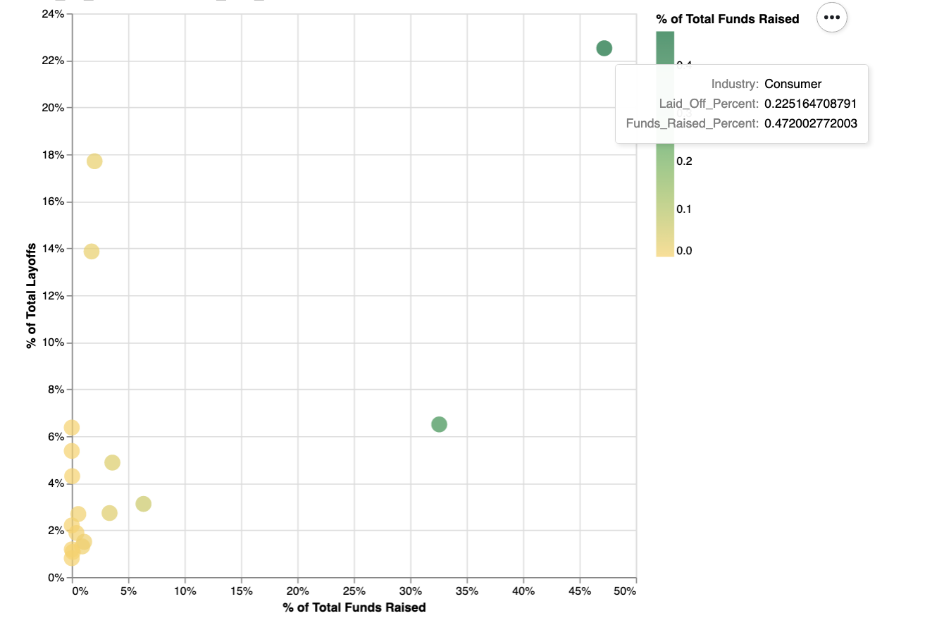
Results
We can observe from the scatter plot that the industry with the highest percentage of total funds raised and highest percentage of total layoffs is the Consumer industry for the subsection of the top 50 companies with the highest number of layoffs.
These companies raised around 47% of the total funds in the subset of data and laid off around 23% of the total layoffs in the subset of data.
Similar to the horizontal bar chart visualization in previous slide, Google and Meta are in the consumer industry and have raised significant levels of capital. To minimize costs and repay funds raised, these companies may use layoffs as an option to meet financial obligations.
Percentage of Total Funding and Percentage of Total Layoffs

Slide 27
Data Abstraction-Tech Layoff
Attribute Name | Attribute Type
company | Categorical
location | Categorical
industry | Categorical
Total_laid_off | Ordinal
Percentage_laid_off | Quantitative
date | Quantitative
stage | Categorical
country | Categorical
Funds_raised | Quantitative
Tech layoff dataset: The layoff dataset has information about the total layoff’s happened during the pandemic. It has a total of 1951 unique fields and of the size 173.73KB

Slide 28
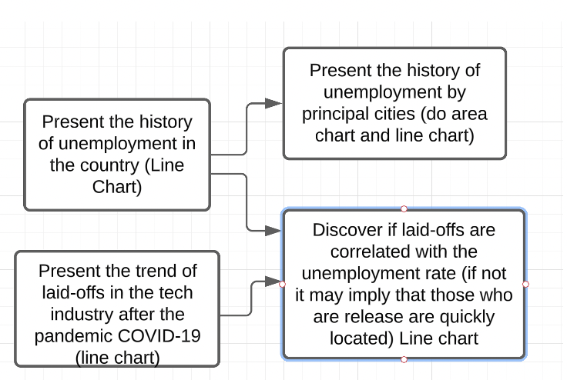
Task Abstraction

Slide 29
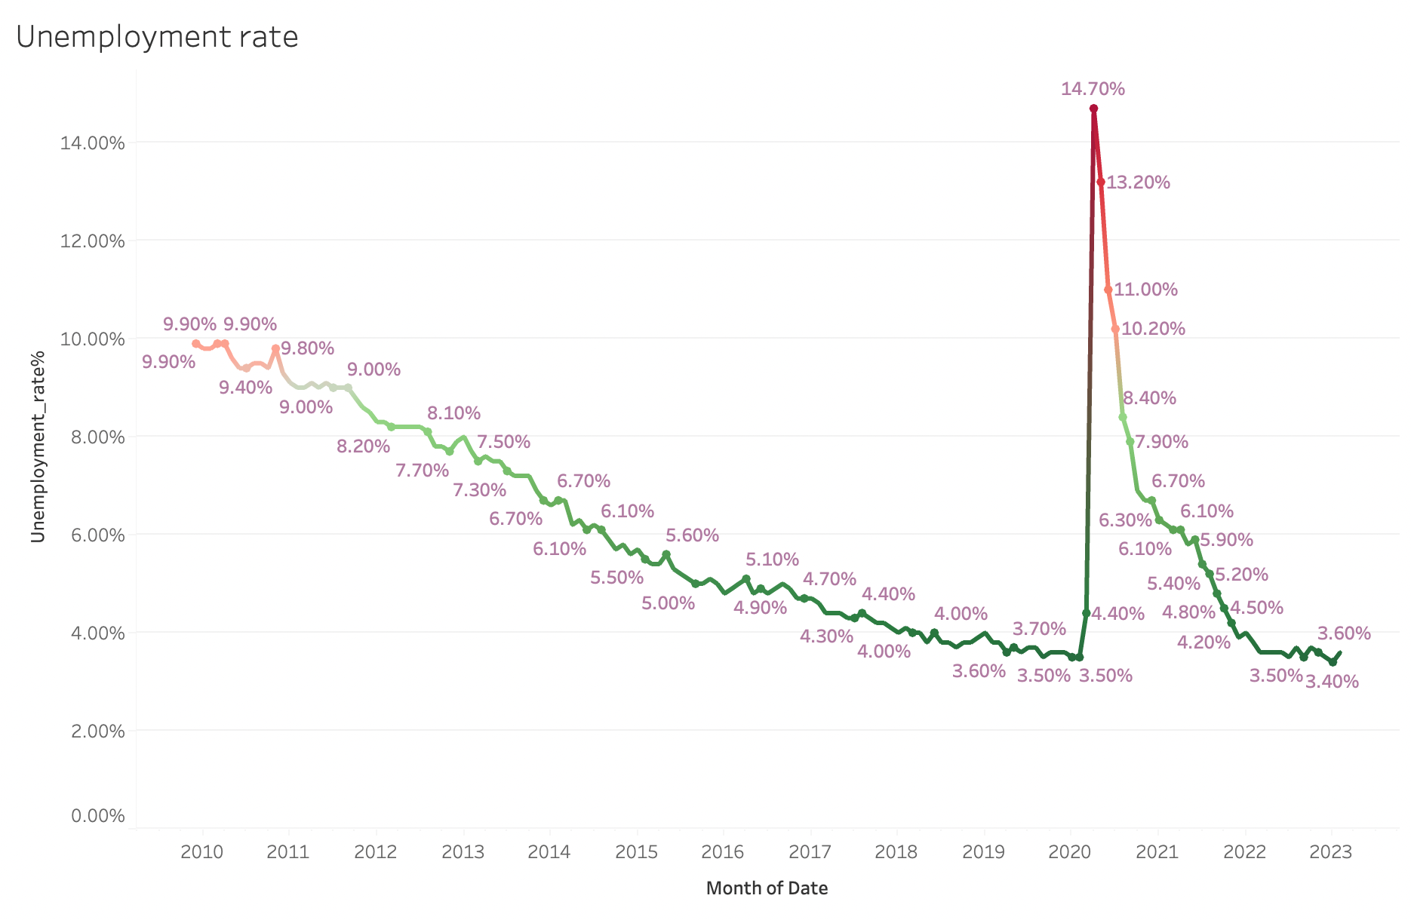
Tableau Results History of Unemployment from the year 2010 - 2023

Slide 30
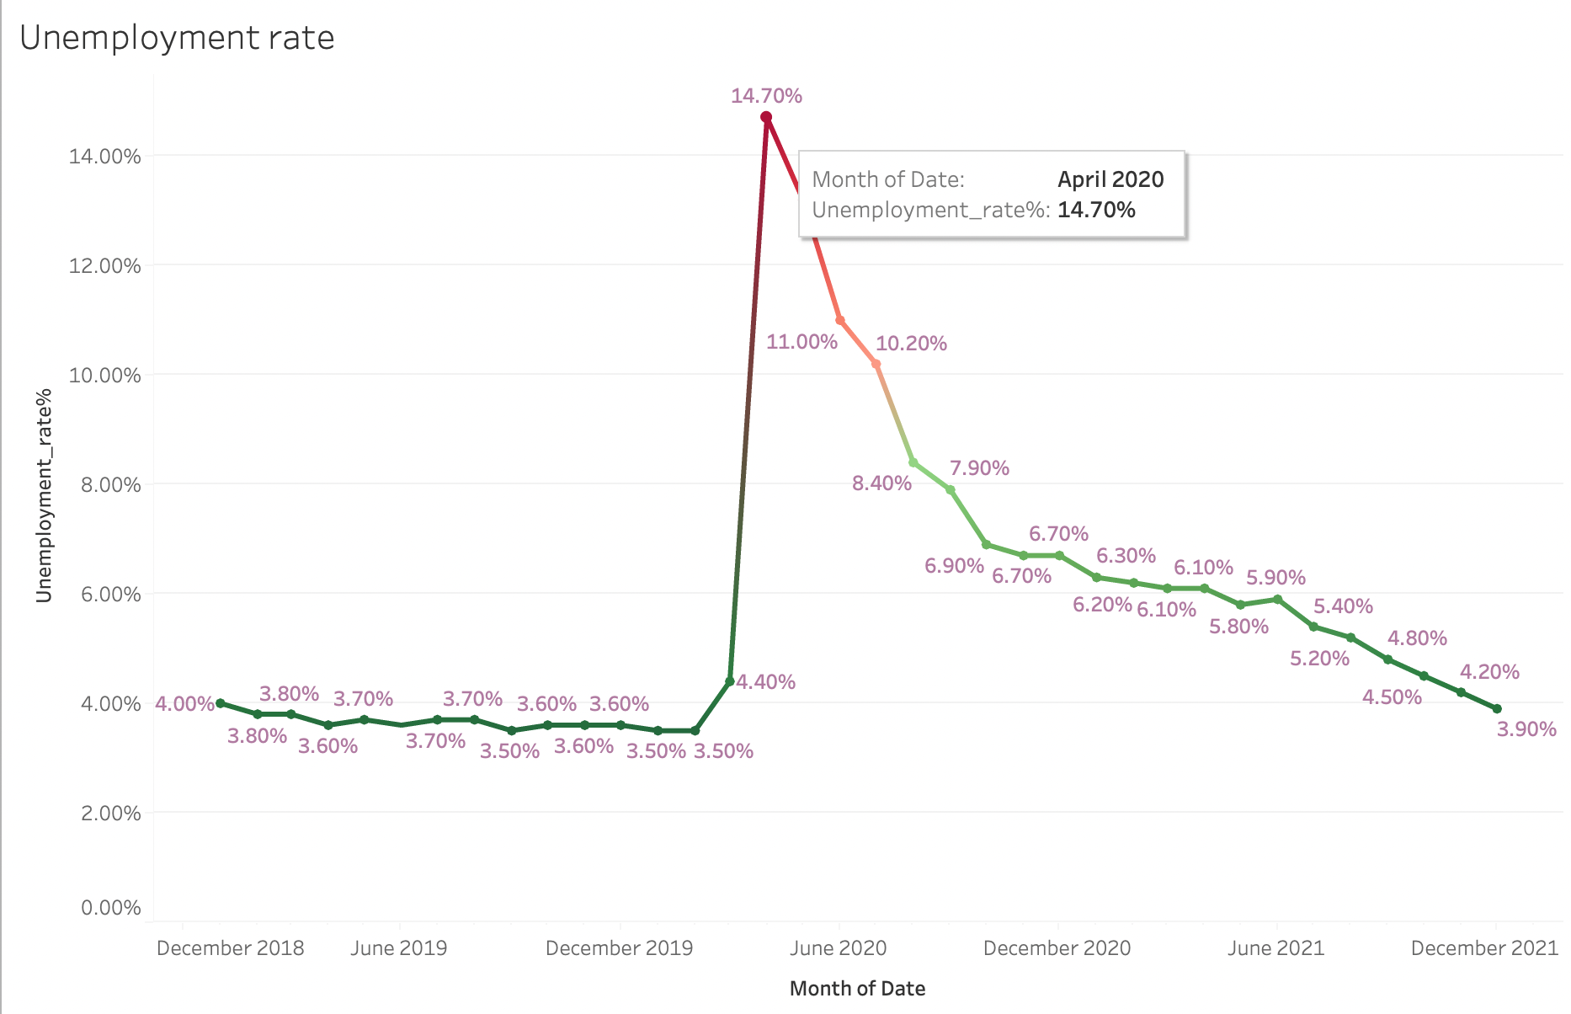
Tableau Results Unemployment rate during the pandemic

Slide 31
Thank you

